Slide 1
FESTIVALS
A Comprehensive Look into Religious Celebrations

Slide 2
Team Members
1. Muhammad Wahaj
2. Abdullah Rafi
3. Jawwad Khan
4. Hassam Nagori

Slide 3
Problem Statement
Understanding and appreciating the diversity of religious festivals around the world is essential for promoting cultural harmony and respect.
Our project aims to provide a visual and interactive way to learn about festivals from different religions.

Slide 4

RELIGIONS:
Religions of our Website.
1.ISLAM
2.CHRISTIANITY
3.JUDAISM
4.BUDDHISM
5.SHINTO
6.SIKHISM
7.HINDUISM
8.TAOISM
9.ZOROASTRIANISM
10.VOODO
We also mentioned 4 Festivals of each Religion in our website.

Slide 5
INTRODUCTION TO RELIGIONS:
Religion is a profound aspect of human life that shapes beliefs, values, and cultures across the world. It offers a path to understanding life’s purpose, fostering a sense of connection, hope, and inner peace. Through shared rituals, teachings, and traditions, religion brings people together, building communities rooted in compassion and mutual respect. It serves as a guide for navigating life's challenges, inspiring individuals to seek spiritual growth and contribute to the greater good. In this presentation, we will explore the essence of religion, its role in shaping societies, and its enduring impact on humanity.

Slide 6
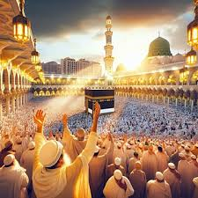
ISLAM
Festivals of Islam in our website
EID-UL-FITR
EID-UL-AZHA
RAMDAN
HAJJ

Slide 7
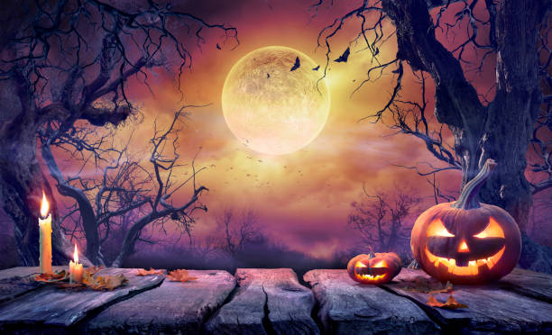
CHRISTIANITY
Festivals of Christianity in our website
EASTER
CHRISTMAS
HALLOWEEN
ADVENT

Slide 8

JUDAISM
Festivals of Judaism in our website
PURIM
SHABBAT
SUKKOT
PASSOVER

Slide 9
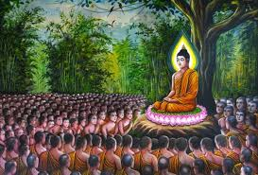
BUDDHISM
Festivals of Buddhism in our website
VESAK
MAGHA PUJA
UPOSATHA
BODHI DAY

Slide 10
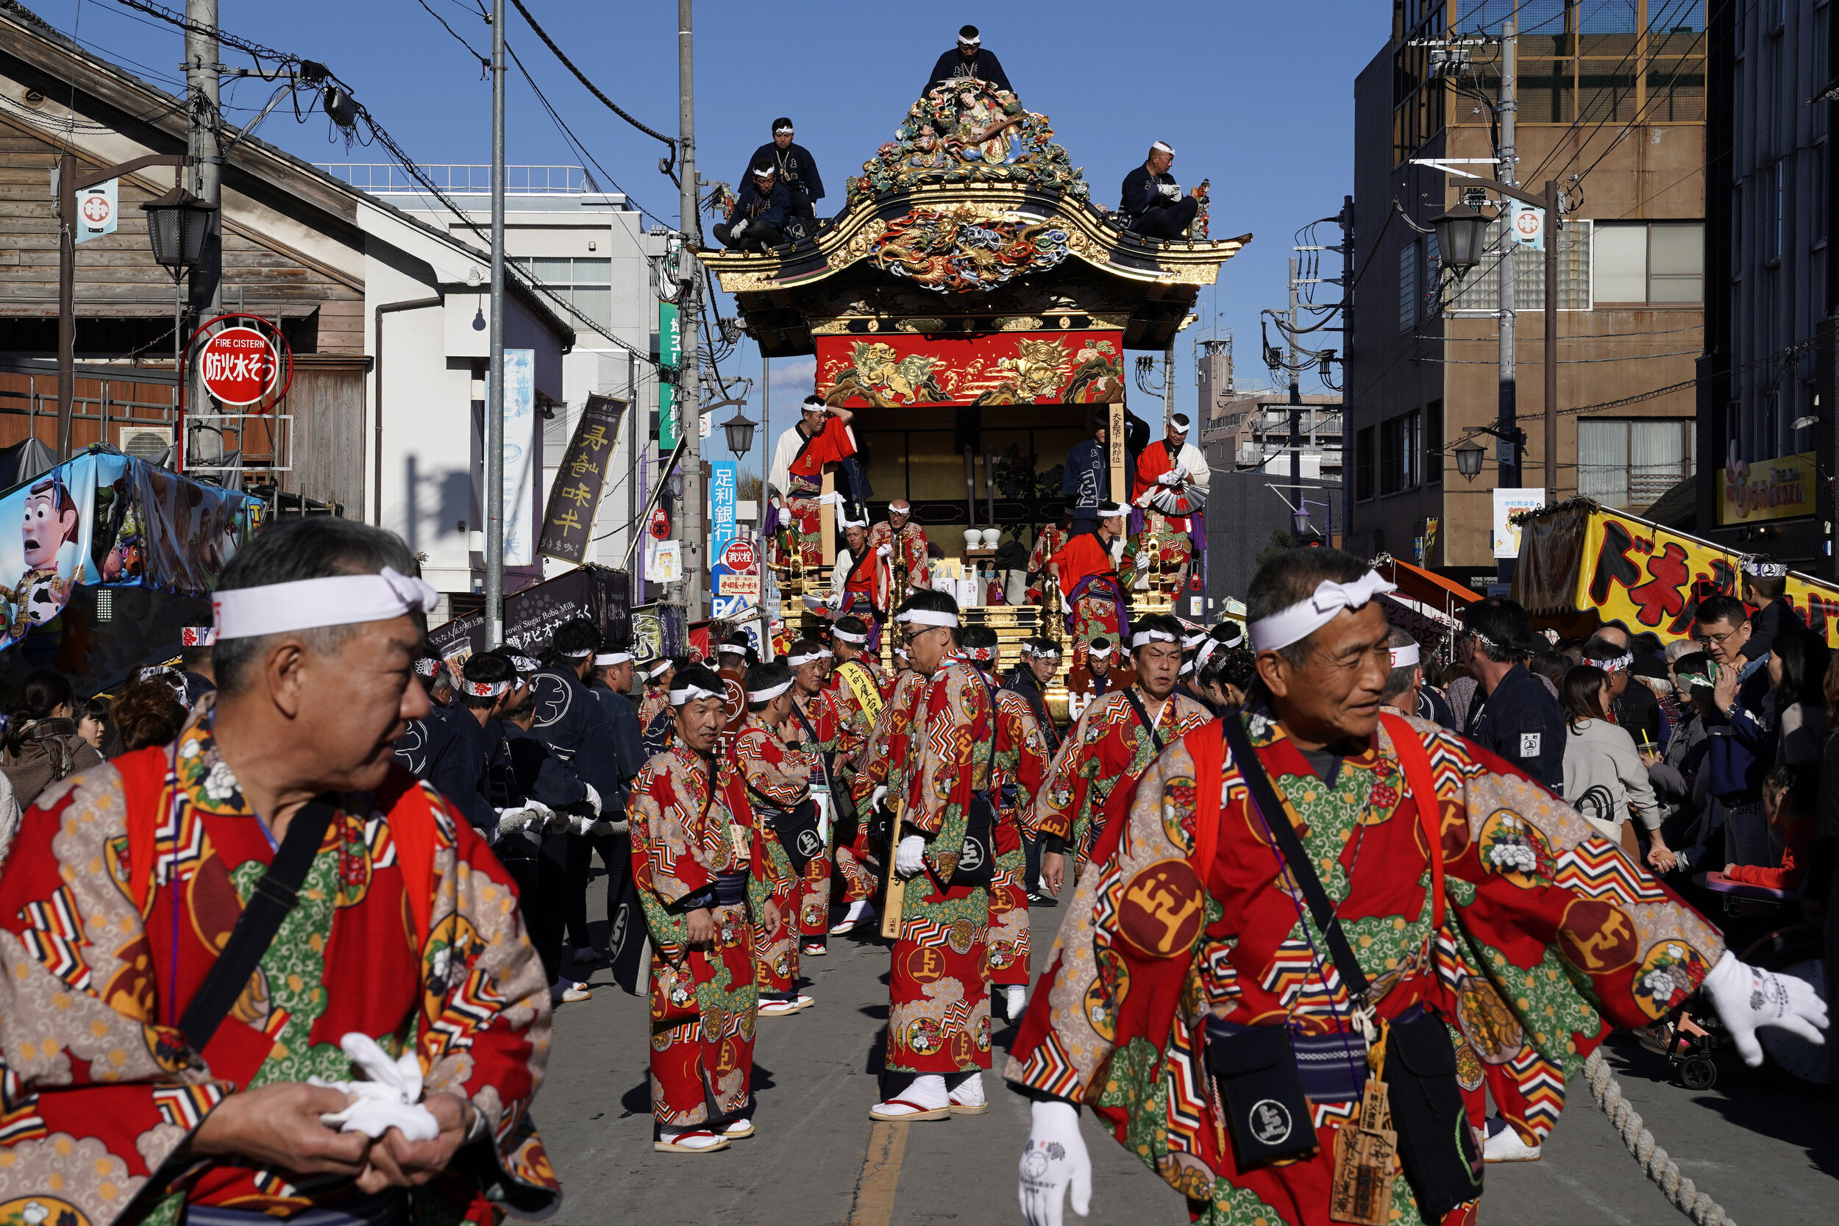
SHINTO
Festivals of Shinto in our website
TORII
HAIDEN
JINJA
GOHEI

Slide 11
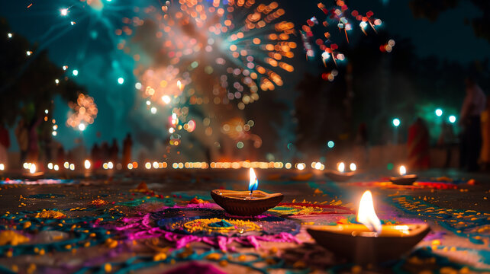
SIKHISM
Festivals of Sikhism in our website
BAISAKHI
MAGHI
DIWALI
LOHRI

Slide 12
HINDUISM
Festivals of Hinduism in our website
HOLI
NAVRATRI
JANMASHTAMI
RAMA NAVAMI

Slide 13
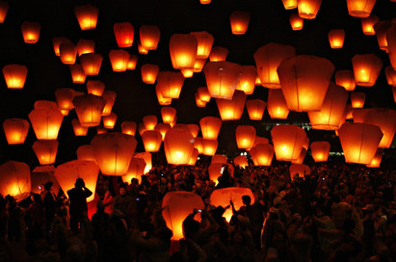
TAOISM
Festivals of Taoism in our website
LANTERN FESTIVAL
QINGMING FESTIVAL
SUPREME PURITY FESTIVAL
ALL SOULS FESTIVAL

Slide 14
ZORAOSTRIANISM
Festivals of Zoroastrianism in our website
AYATHRIMA
MAIDHYAIRYA
NOWRUZ
GAHANBAR

Slide 15
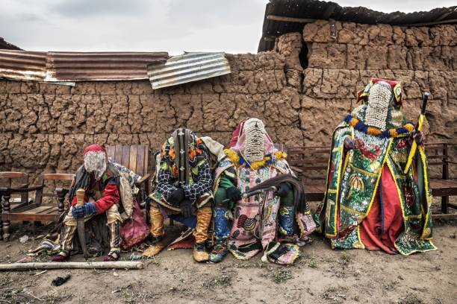
VOODOO
Festivals of Voodoo in our website
OUIDAH VOODOO FESTIVAL
VOODOOFEST
FESTIVAL OF YEMANJA

Slide 16
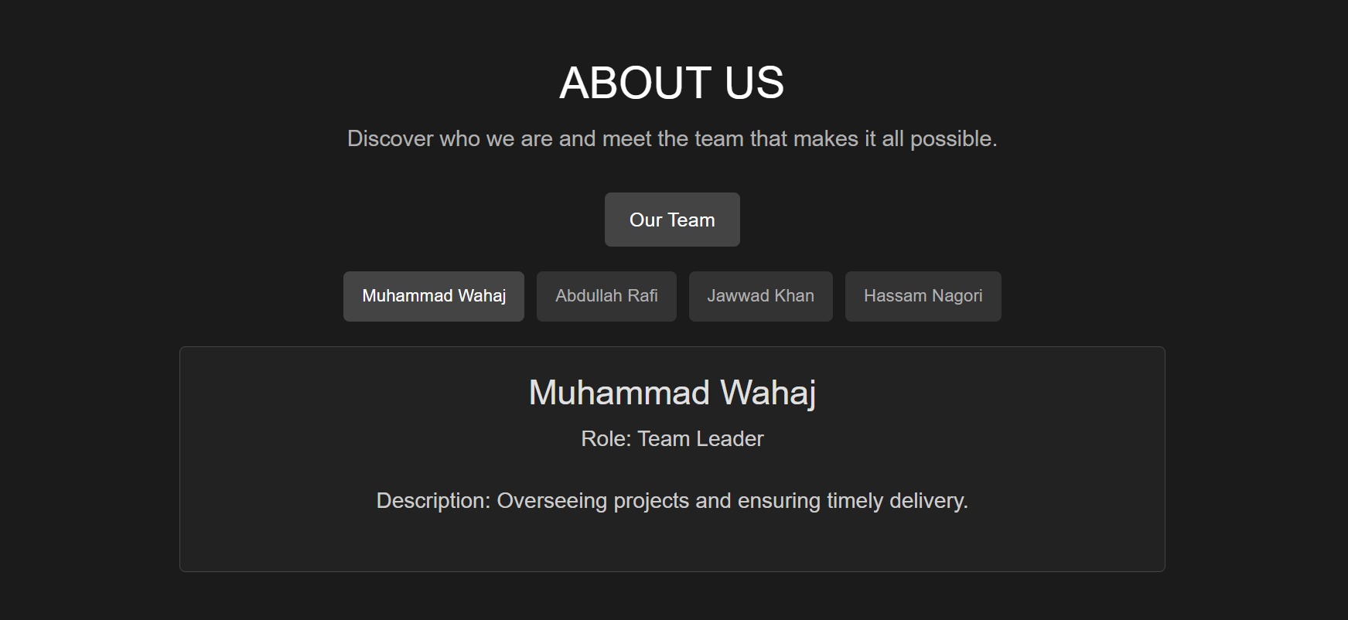
ABOUT US PAGE

Slide 17
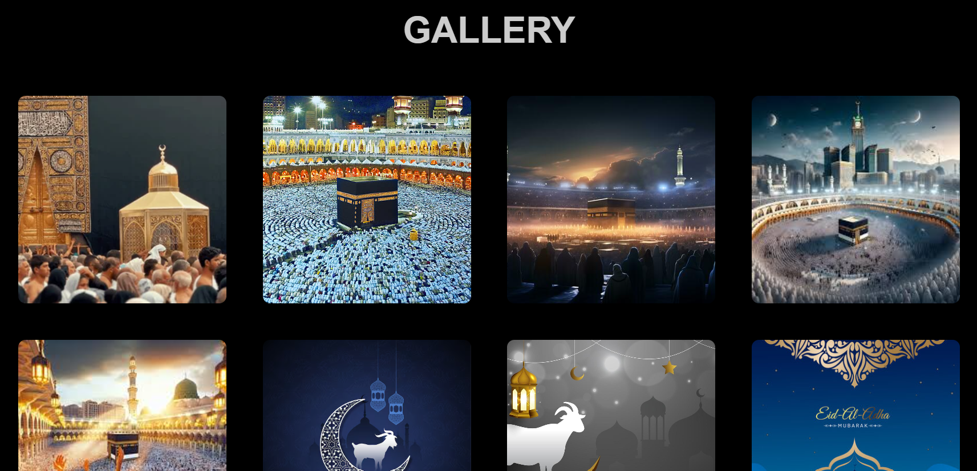
GALLERY

Slide 18
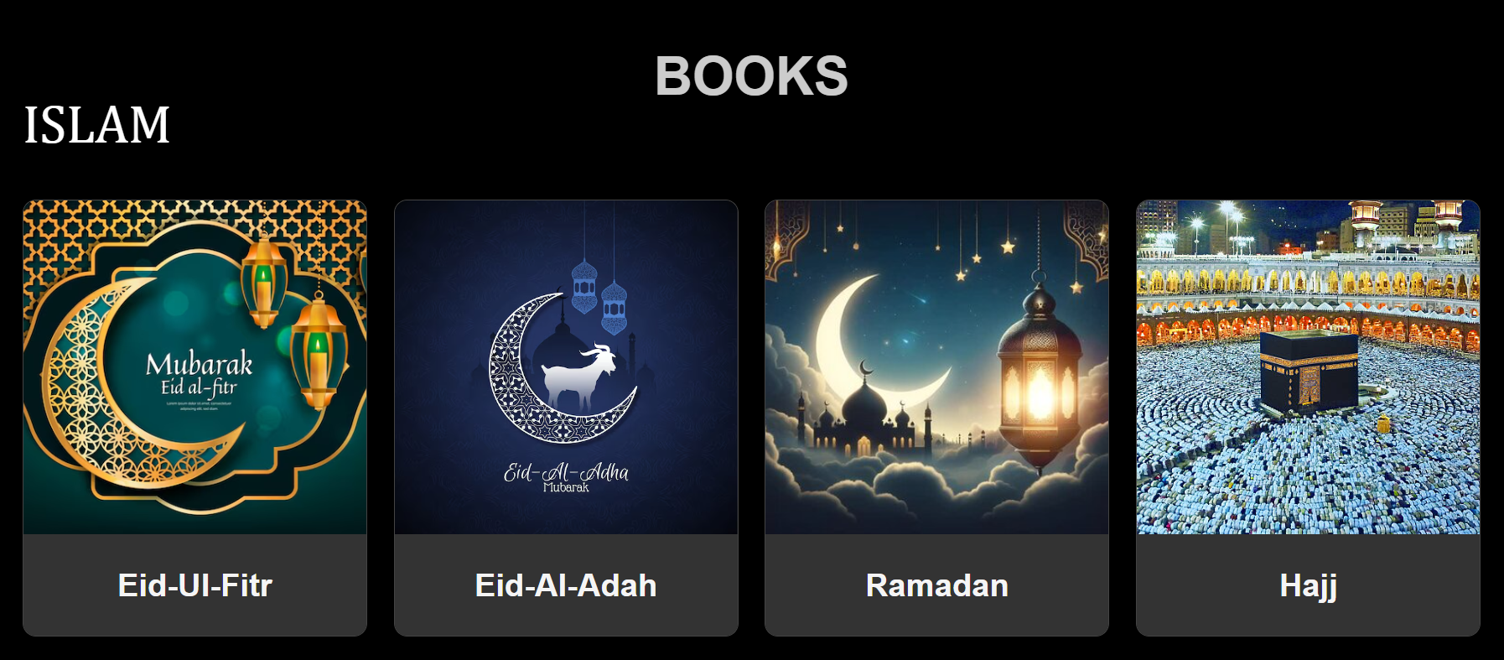
BOOKS

Slide 19
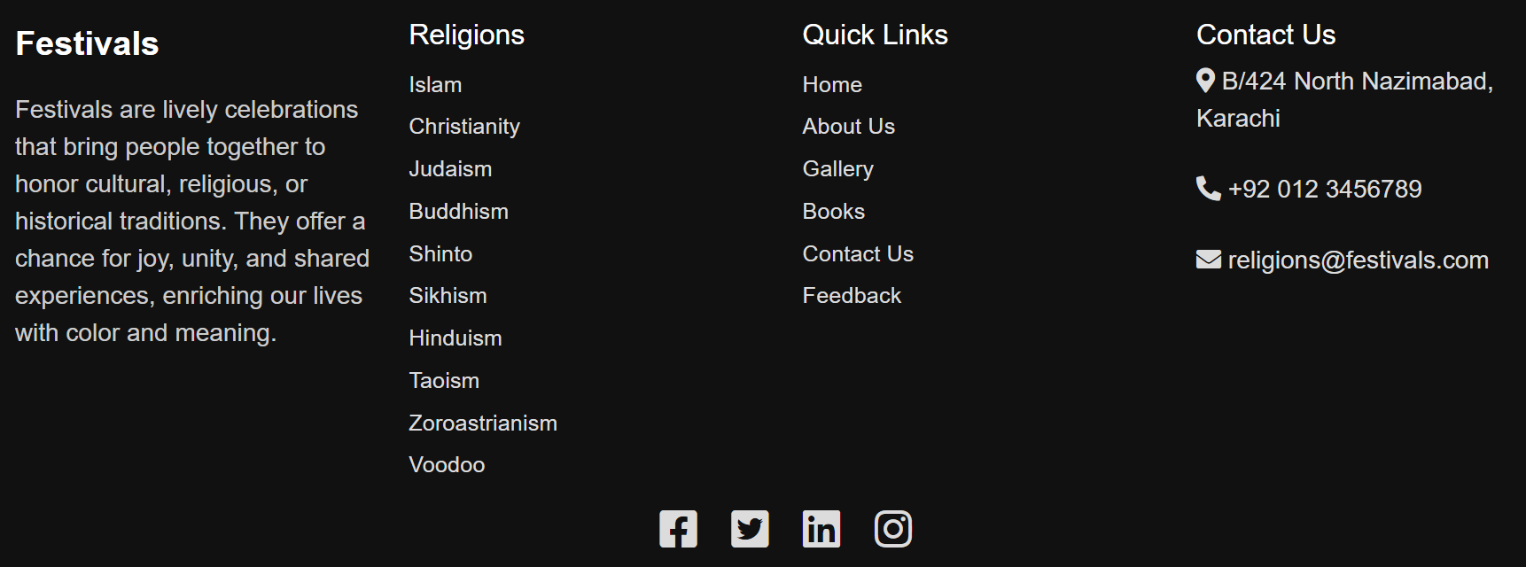
FOOTER

Slide 20
Thank You!
Thank you all for your time and attention today. I truly appreciate the opportunity to share this information with you, and I hope you found it valuable and insightful. If you have any questions or would like to discuss further, please don’t hesitate to reach out. Your feedback is always welcome, and I look forward to connecting with you all again soon.

